Slide 1
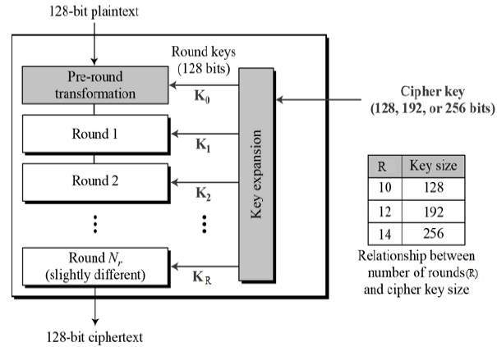
AES Block Cipher
The Advanced Encryption Standard (AES), also called Rijndael, is a symmetric block cipher with a block length of 128 bits and support for key lengths of 128, 192, and 256 bits. It was published by NIST (National Institute of Standards and Technology) in 2001. Here, we assume a key length of 128 bits, which is likely to be the one most commonly implemented.

Slide 2
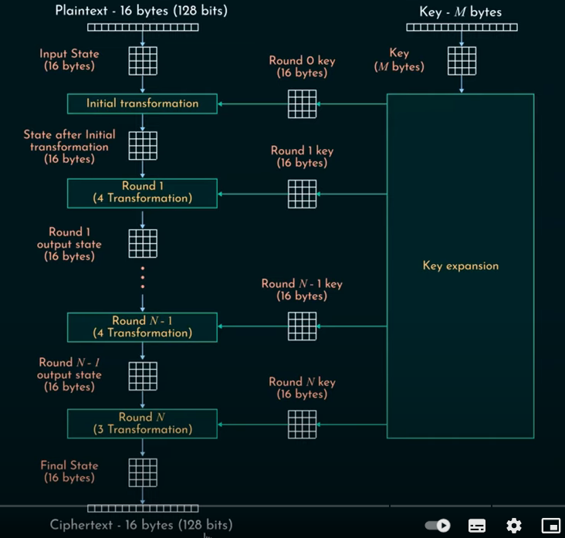

Slide 3

AES Block Cipher
The AES Algorithm:
AES operates on a 4 × 4 column-wise order array of bytes, called the state. For instance, if there are 16 bytes, these bytes are represented as this two-dimensional array:
The key size used for an AES cipher specifies the number of transformation rounds that convert the plaintext into the ciphertext . The number of rounds are as follows:
10 rounds for 128-bit keys.
12 rounds for 192-bit keys.
14 rounds for 256-bit keys.
Each round consists of several processing steps, including one that depends on the encryption key itself. A set of reverse rounds are applied to transform ciphertext back into the original plaintext using the same encryption key.

Slide 4
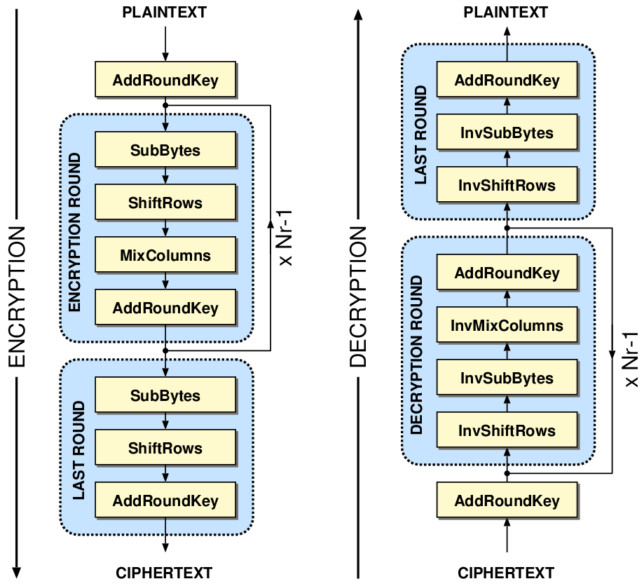
AES Block Cipher
The AES Encryption Algorithm:
The AES algorithm can be broken into three phases: the initial round, the main rounds, and the final round. All of the phases use the same sub-operations in different combinations as follows:
Initial Round
AddRoundKey
Main Rounds (1,2…Nr-1)
SubBytes
ShiftRows
MixColumns
AddRoundKey
Final Round (Nr)
SubBytes
ShiftRows
AddRoundKey
Note that in the above figure, KeyExpansion: round keys are derived from the cipher key using key expansion algorithm. AES requires a separate 128-bit round key block for each round plus one more.

Slide 5
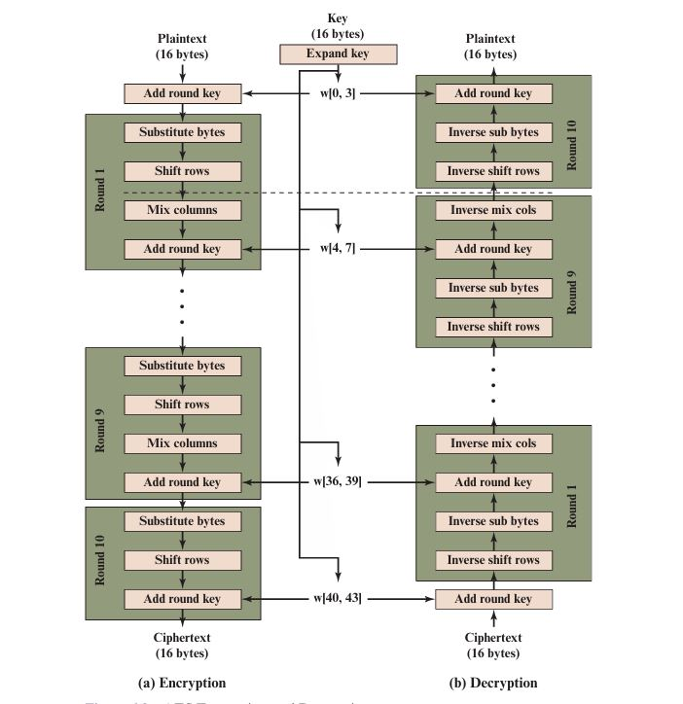

Slide 6
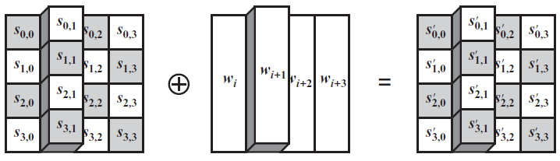
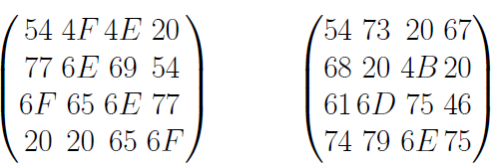
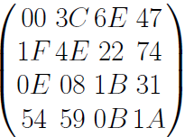
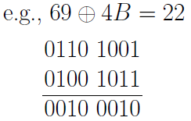

AES Block Cipher
AddRoundKey: In this operation, the 128 bits of State are bitwise XORed with the 128 bits of the round key. Here is an example where the first matrix is State, and the second matrix is the round key.
e.g.
=
$$$$

Slide 7
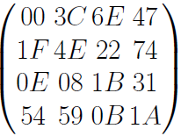
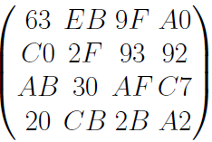
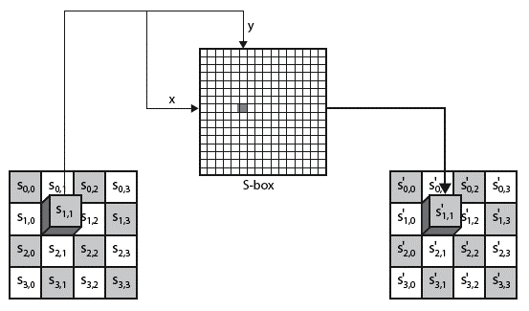
AES Block Cipher
SubBytes: A nonlinear substitution step where each entry (byte) of the current state matrix is substituted by a corresponding entry in the AES S-Box. For instance: byte (6E) is substituted by the entry of the S-Box in row 6 and column E, i.e., by (9F). (The byte input is broken into two 4-bit halves. The first half determines the row and the second half determines the column).
e.g.:
state = ⇒ S_box(State) =

Slide 8
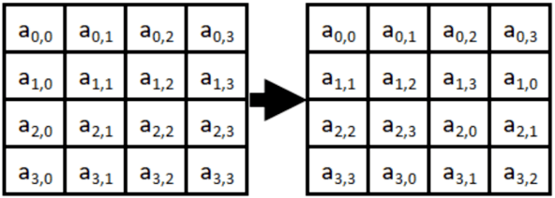
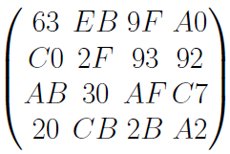
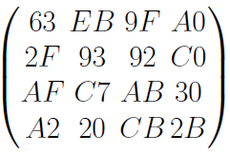
AES Encryption Cipher
ShiftRows: A transposition step where the four rows of the state are shifted cyclically to the left by offsets of 0, 1, 2, and 3.
e.g.:
e.g.:
⇒

Slide 9
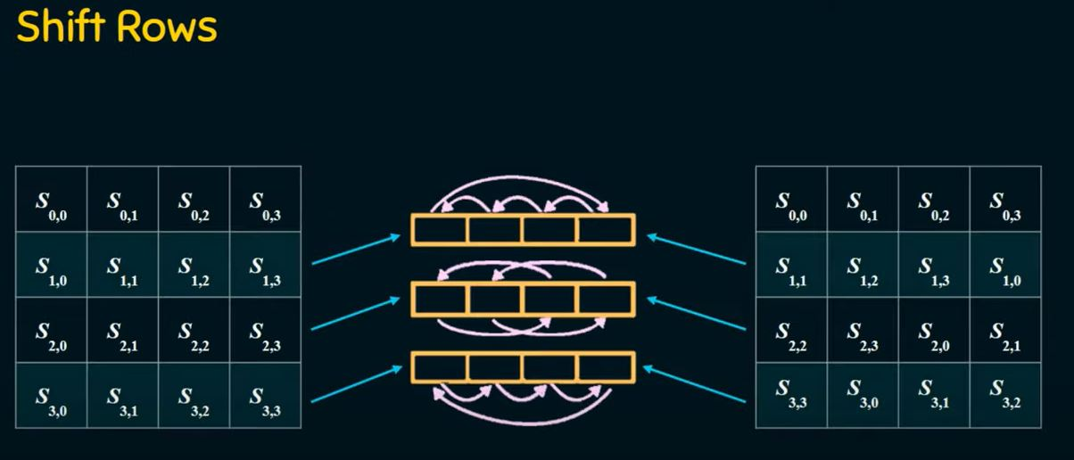

Slide 10
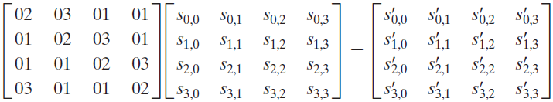
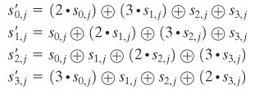
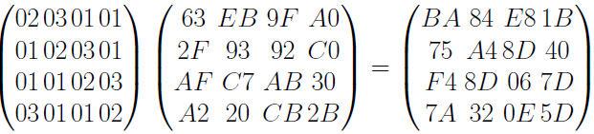
AES Block Cipher
MixColumns: a linear mixing operation which multiplies fixed matrix against current State Matrix:
Unlike standard matrix multiplication, MixColumns performs matrix multiplication as per Galois Field (2⁸).
e.g.:

Slide 11
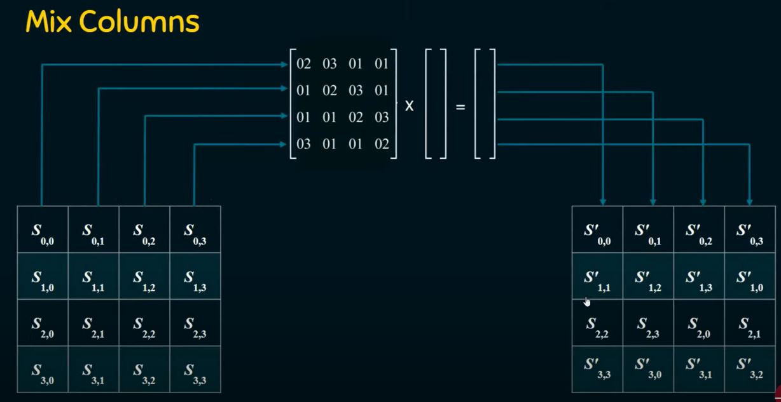

Slide 12
AES KEY EXPANSION:
The AES key expansion method receives a four-word (16-byte) key and returns a linear array of 44 words (176 bytes). This is sufficient to provide both the initial AddRoundKey step and a four-word round key for each of the cipher's ten rounds.
Initial Key − The algorithm makes use of an initial key. Depending on the level of security needed, this key's length can range from 128 to 256 bits.
Round Constants − The approach makes use of a set of round constants, which are predefined values used in the key expansion process.
Word Size − The key divides words into individual blocks. A word typically has 32 bits in it. For example, four 32-bit words are created from a 128-bit key.
Key Schedule − The term "key schedule" refers to a set of round keys generated using the key expansion process. The initial round key and the extra round keys that were derived from it are both included in this schedule.
Expansion Rounds − The algorithm performs several tasks in each expansion round, such as −
RotWord − This function rotates the bytes in a word.
SubWord − Applyes a substitution operation using a predetermined S-box.
Rcon − XORs the word using a round constant.
Round Keys − The order of round keys that are still in place following all expansion rounds defines the key schedule. Each round key is used in the corresponding round of AES encryption or decryption.

Slide 13
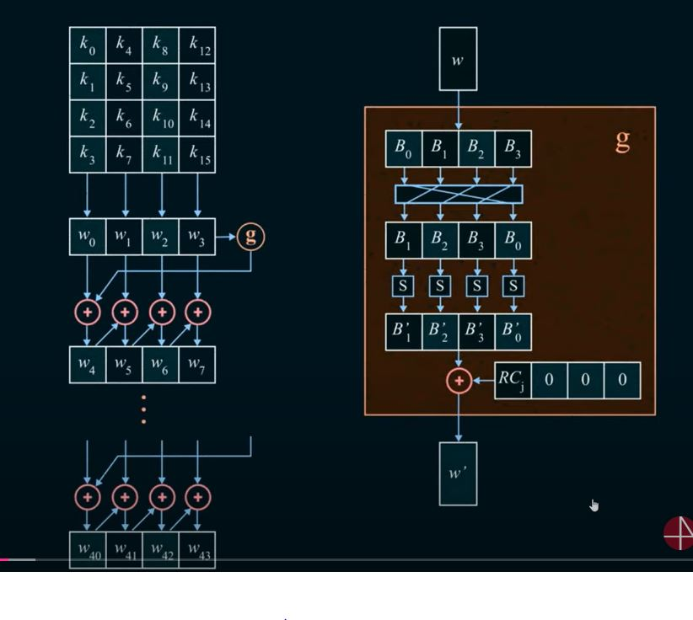

Slide 14
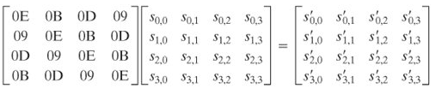
AES Block Cipher
The AES Decryption Algorithm:
AddRoundKey:
Add Roundkey transformation is identical to the forward add round key transformation, because the XOR operation is its own inverse.
Inverse SubBytes:
This operation can be performed using the inverse S-Box. It is read identically to the S-Box matrix.
InvShiftRows:
Inverse Shift Rows performs the circular shifts in the opposite direction for each of the last three rows, with a one-byte circular right shift for the second row, and so on.
InvMixColumns:
The inverse mix column transformation is defined by the following matrix multiplication in Galois Field (2⁸):

Slide 15
BLOWFISH
Blowfish was developed by Bruce Schneier, and has the reputation of being a very strong symmetric key cryptographic algorithm. According to Schneier, Blowfish was designed with the following objectives in mind.
(a) Fast Blowfish encryption rate on 32-bit microprocessors is 26 clock cycles per byte.
(b) Compact Blowfish can execute in less than 5 KB memory.
(c) Simple Blowfish uses only primitive operations, such as addition, XOR and table look-up, making its design and implementation simple.
(d) Secure Blowfish has a variable key length up to a maximum of 448 bits long, making it both flexible and secure.

